Slide 1
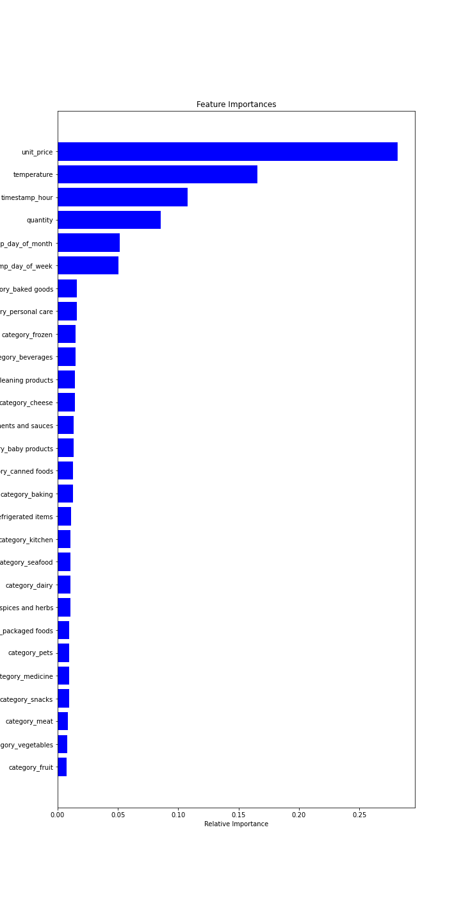
Work done on Stock Prediction
Feature Importance
Data sets provided by the client
Incorporated data exploration, data cleaning & data Merging
Performed feature engineering & used k-fold cross validation
Model used is ‘Random Forest Regressor’ for prediction
Scaled the data and computed accuracy, using mean absolute error (MAE)
Model is predicting robustly
Due to small samples of data, value of MAE is large (accuracy as a percentage was around 50%)
Utilizing feature importance, found that:
‘product categories’ were insignificant
‘unit price’ and ‘temperature’ were crucial in predicting stock
‘hour of day’ was also important for predicting stock

